Slide 1

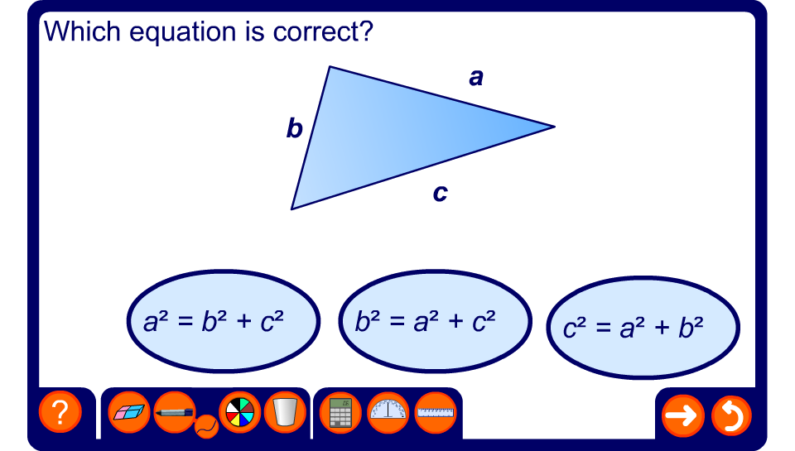


Find the correct equation
Notes:
One of the most common errors when solving problems involving Pythagoras’ Theorem is failing to identify which side is the hypotenuse before writing the equation of the relationship between the sides.
For each of the examples in the activity ask pupils to identify the hypotenuse before selecting the correct equation.
Encourage pupils to go through the process of identifying the hypotenuse and writing down Pythagoras’ Theorem before attempting to solve any problem involving the lengths of the sides of right-angled triangles.

